Slide 1
Chapter 15 Plotting

Slide 2
15.1 Introduction to Plotting and Visualizing Data
For plotting in Python download and install the MATLAB package matplotlib from
http://matplotlib.org/downloads.html
NumPy package is also required by matplotlib
Notes:
Usually matplotlib requires numpy library as well.

Slide 3
15.1 Introduction to Plotting and Visualizing Data
import matplotlib.pyplot as plt #renames package for easy use

Slide 4
15.1 Introduction to Plotting and Visualizing Data
import matplotlib.pyplot as plt #renames package for easy use
plt.plot( x, y ) #values for x axis and y axis

Slide 5
15.1 Introduction to Plotting and Visualizing Data
import matplotlib.pyplot as plt #renames package for easy use
plt.plot( x, y ) #values for x axis and y axis
if only one argument is passed then 0 .. n is assumed for x axis

Slide 6
15.1 Introduction to Plotting and Visualizing Data
import matplotlib.pyplot as plt #renames package for easy use
plt.plot( x, y ) #values for x axis and y axis
if only one argument is passed then 0 .. n is assumed for x axis
multiple plot statements generates multiple lines

Slide 7
15.1 Introduction to Plotting and Visualizing Data
import matplotlib.pyplot as plt #renames package for easy use
plt.plot( x, y ) #values for x axis and y axis
if only one argument is passed then 0 .. n is assumed for x axis
multiple plot statements generates multiple lines
plt.show() #display plot/graph
Notes:
Only need to show once; do plt.show again to refresh your graph and reoutput if the plot was updated.

Slide 8
15.2 Styling Plots
plot() has optional format string
plot( x, y, ‘r--’) means to use red color using a dashed line

Slide 9
15.2 Styling Plots
plot() has optional format string
plot( x, y, ‘r--’) means to use red color using a dashed line
default value is ‘b-’, meaning solid blue line

Slide 10
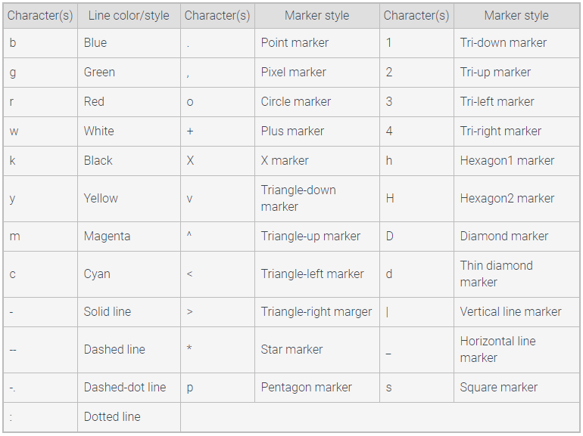
15.2 Styling Plots
Notes:
Can you put the 3 (rgb) hex number values for the color? –probably yes.

Slide 11
15.2 Styling Plots – line properties
format strings are shortcuts for setting line properties
line property is an attribute of line object, created when plot() is called
line property determines how line is displayed when show() is called

Slide 12
15.2 Styling Plots – line properties
format strings are shortcuts for setting line properties
line property is an attribute of line object, created when plot() is called
line property determines how line is displayed when show() is called
There are more properties than just color and style …

Slide 13
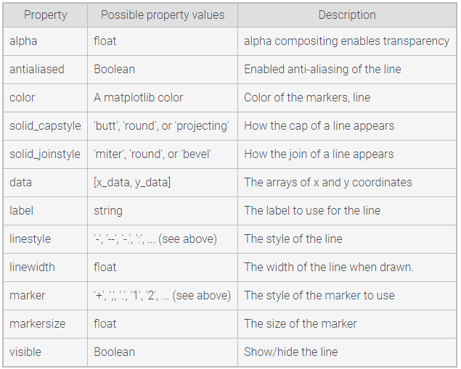
15.2 Styling Plots – line properties
Property values defines type of data to specify, such as alpha=3.2
Notes:
Can do for example: color=(number value, or string parameters as shown on previous slide)

Slide 14
15.2 Styling Plots – line properties
.legend() is used to add a legend
label arguments are passed to plot using parameter label
plt.plot( x, y, label=“years of service”)

Slide 15
15.2 Styling Plots – line properties
.legend() is used to add a legend
label arguments are passed to plot using parameter label
plt.plot( x, y, label=“years of service”)
other keyword arguments to legend modify its appearance
shadow=, loc=, etc.

Slide 16
15.3 Text and annotations
.title(“ “) #add title to plot

Slide 17
15.3 Text and annotations
.title(“ “) #add title to plot
.text( x, y, “ “) #add text at x,y

Slide 18
15.3 Text and annotations
.title(“ “) #add title to plot
.text( x, y, “ “) #add text at x,y
.axvline( val ) #draw vertical line at x axis point val

Slide 19
15.3 Text and annotations
.title(“ “) #add title to plot
.text( x, y, “ “) #add text at x,y
.axvline( val ) #draw vertical line at x axis point val
.xlabel( “ “ ) #label for x axis
.ylabel( “ “ ) #label for y axis

Slide 20
15.3 Text and annotations
.title(“ “) #add title to plot
.text( x, y, “ “) #add text at x,y
.axvline( val ) #draw vertical line at x axis point val
.xlabel( “ “ ) #label for x axis
.ylabel( “ “ ) #label for y axis
.annotate( “ “, xy=(1,2), xytext=(3,4) ) #adds annotation onto plot, with arrow to
#xy point and text at xytext point
#can also modify arrow

Slide 21
15.4 Numpy
tools for scientific and mathematical computations

Slide 22
15.4 Numpy
tools for scientific and mathematical computations
linear algebra
fast fourier transforms
statistics

Slide 23
15.4 Numpy
tools for scientific and mathematical computations
linear algebra
fast fourier transforms
statistics
downloaded from http://www.scipy.org/scipylib/download.html

Slide 24
15.4 Numpy
uses array data, conceptually similar to a list

Slide 25
15.4 Numpy
uses array data, conceptually similar to a list
my_array = np.array( [1, 2, 3] )
1 dimensional array with 3 elements

Slide 26
15.4 Numpy
uses array data, conceptually similar to a list
my_array = np.array( [1, 2, 3] )
1 dimensional array with 3 elements
my_array2 = mp.array( [1,2,3], [4,5,6] )
2 dimensional array: 2 rows, 3 columns

Slide 27
15.4 Numpy
create an array prefilled with 1’s or 0’s
np.zeros( (1,9) ) #1 row x 9 columns, filled with 0’s

Slide 28
15.4 Numpy
create an array prefilled with 1’s or 0’s
np.zeros( (1,9) ) #1 row x 9 columns, filled with 0’s
np.ones( ( 4,5) ) #4 rows x 5 columns, filled with 1’s

Slide 29
15.4 Numpy
Create a sequence of fractional numbers
np.linespace( 0,10,1000) #1000 elements between 0 and 10

Slide 30
15.4 Numpy
array operations:
perform stated operation between similar positions in two like-sized arrays

Slide 31
15.4 Numpy
array operations:
perform stated operation between similar positions in two like-sized arrays
ary1 + ary2
ary1 – ary2
ary1 * ary2
np.dot( ary1, ary2 ) dot product multiplication
np.sqrt( ary1) ) square root of each element in array
ary1.min() minimum element in array
ary1.max() maximum element in array

Slide 32
15.5 multiple plots
.figure( “ “ ) allows creation of multiple plots that are shown at one time

Slide 33
15.5 multiple plots
.figure( “ “ ) allows creation of multiple plots that are shown at one time
.axis( x1,x2, y1,y2 ) specifies x,y range of figure 1 and figure 2

Slide 34
15.5 multiple plots
.figure( “ “ ) allows creation of multiple plots that are shown at one time
.axis( x1,x2, y1,y2 ) specifies x,y range of figure 1 and figure 2
.subplot( ) allows creation of multiple plots in one figure

Slide 35
15.5 multiple plots
.figure( “ “ ) allows creation of multiple plots that are shown at one time
.axis( x1,x2, y1,y2 ) specifies x,y range of figure 1 and figure 2
.subplot( ) allows creation of multiple plots in one figure
.twinx( ) common x axis but two different y axis on same plot
left_axis
right_axis used to specify values for each unique y axis
such as labels, colors, range

